Slide 1
Data Structures
Outcomes:
Become familiar with data structures in Python
Familiarize yourself with Lists, Dictionaries, and Arrays.
Python programming tools for data management
Apply the knowledge in processing, analyzing, and modifying datasets for targeted outcomes.

Slide 2
Basic Data Structures
Lists
Dictionaries
Arrays

Slide 3
Lists are ordered sequences of data. Elements: numbers, strings, lists of lists, etc. Operations: Add, remove, change/modify Example myList= [math.pi, 3.14, 'apple', 'How are you?', [3, 'ok’]] Try the following and see what happens to the list? (Exam question) print (myList[1]) myList.remove('How are you?’) myList.append(123)

Slide 4
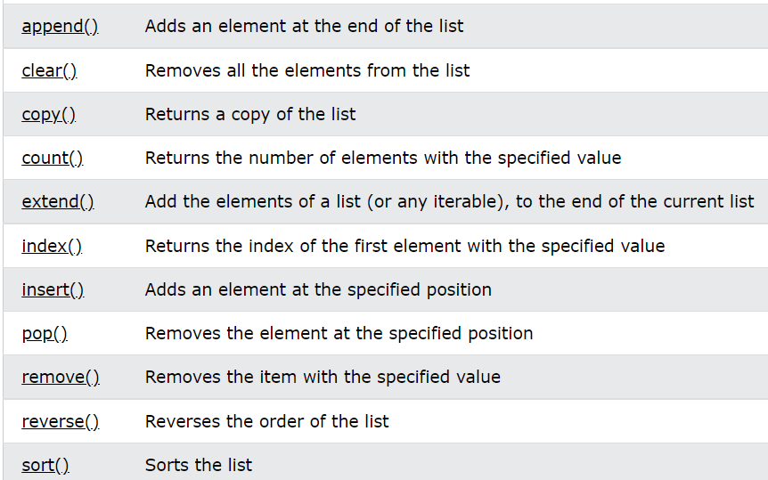
Operations on Lists

Slide 5
Dictionary lets you store items in “pairs” * [key, value] pair in python MyDict ={‘key1’: ‘value1’, ‘key2’: ‘value2’} Notice “Key:Value” pairs! print (MyDict [‘key2’]) #returns value1 MyDict[‘key3’] = ‘value3’ MyList.append(123) MyList.length() [3.14, 'apple', [3, 'ok'], 123]
Dictionary Object

Slide 6
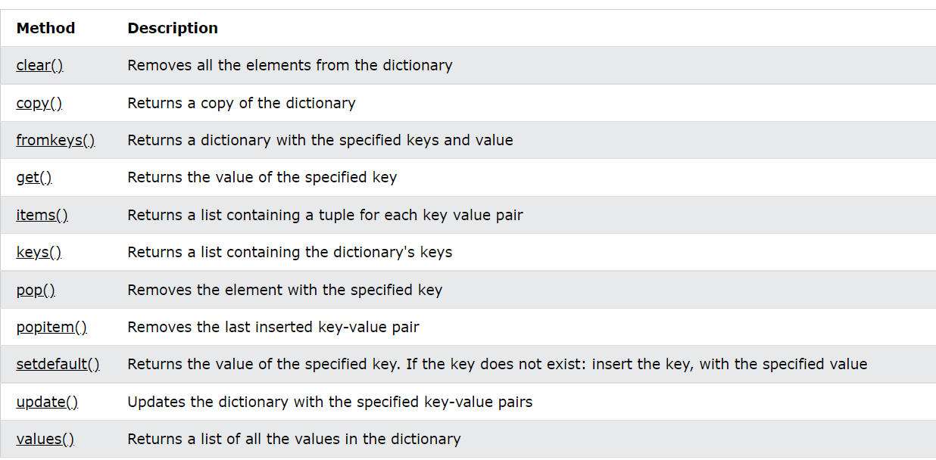
Operations on Dictionary Object

Slide 7
Arrays are collections of elements in a single data type We use numpy for array support in python. Arrays provide contiguous data store support: Efficient on store/retrieve. Examples data = np.array([[3,6], [9,12]]) print (data/3) [[1,2], [3,4]] print (data[1,1]) ?

Slide 8
Follow Tutorials Basic Data Structures Basic Language Syntax Functions Loops and Control Structures

